Slide 1
Long list of initiatives
2
Phosphorus
Nitrogen
Comment
Our current reduction target is:
xxx
xxx
xxx
Actions needed to reach target
  Action 1
xxx
xxx
xxx
  Action 2
xxx
xxx
xxx
  Action 3
xxx
xxx
xxx
  Action 4
xxx
xxx
xxx
  Action 5
xxx
xxx
xxx
  Action 6
xxx
xxx
xxx
  Action 7
xxx
xxx
xxx
∑ xxx
∑ xxx

Slide 2
Prioritize initiatives: Continuation of exercise at innovation lab
3
1
2
3
Success factor/
Strategic objective
High
Low
High
Low
High
Low
NP reduction potential
  E.g.
  1 due to...
  3 due to...
  5 due to...
  E.g.
  2 due to...
  4 due to...
Efforts needed
  E.g.
  1 due to...
  3 due to...
  5 due to...
  E.g.
  2 due to...
  4 due to...
Benefits (other than NP reduction)
  E.g.
  1 due to...
  3 due to...
  5 due to...
  E.g.
  2 due to...
  4 due to...
Other
  E.g.
  1 due to...
  3 due to...
  5 due to...
  E.g.
  2 due to...
  4 due to...

Slide 3
Prioritize initiatives: Allocate initiatives in matrix
3
Allocate the initiatives / actions from previous pages according to their scoring of efforts and NP reduction potential
Low
Consider
Prioritize
Efforts needed
Assess alternative opportunities
Consider
High
Low
NP reduction potential
High

Slide 4
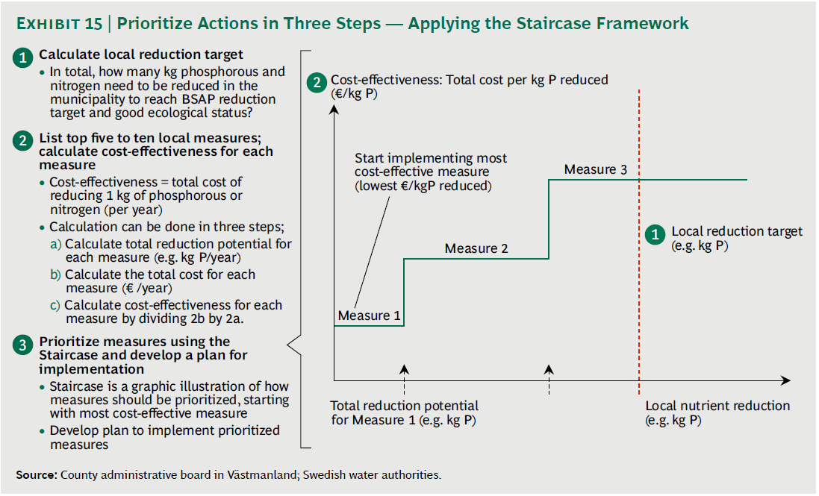
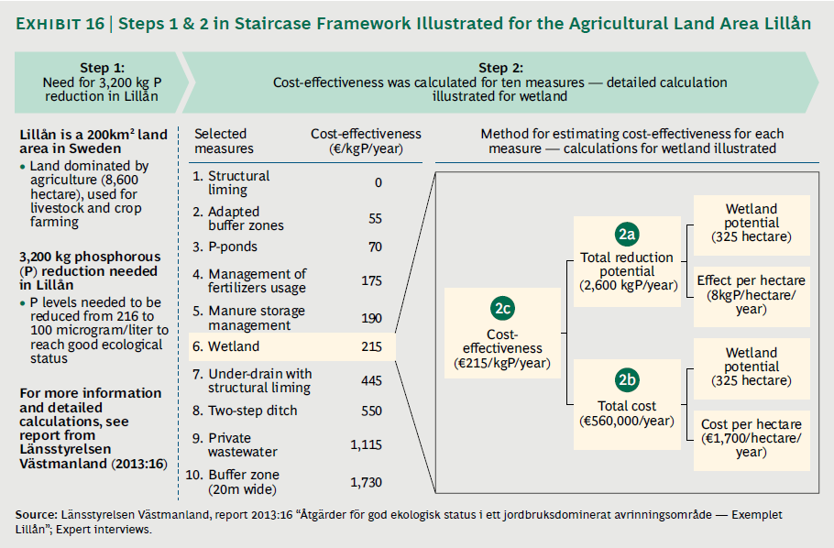
Method for calculating the staircase framework
3
1
Calculate the local nutrient reduction target
2
List top 5-10 local measures to reduce nutrient discharges and calculate for each measure:
  Reduction potential (i.e. how much the measure can reduce within the municipality)
  Cost for each measure (i.e. cost for creating/building the measure)
  Cost-effectiveness for each measure (i.e. potential divided by total cost)
3
Prioritize measures using the framework
  Start with the measure with the lowest cost per kg
  Use that measure to its full potential
  Then, continue with the measure with the next lowest cost per kg and use that to its full potential – and continue this way until you reach full reduction target
Example from the BCG and Zennström report

Slide 5
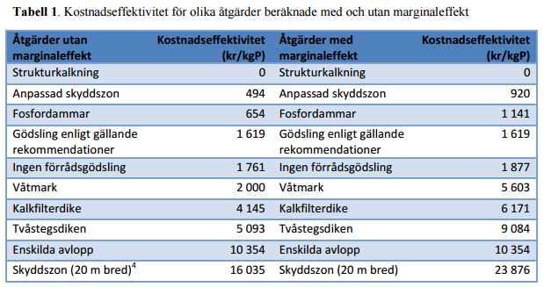
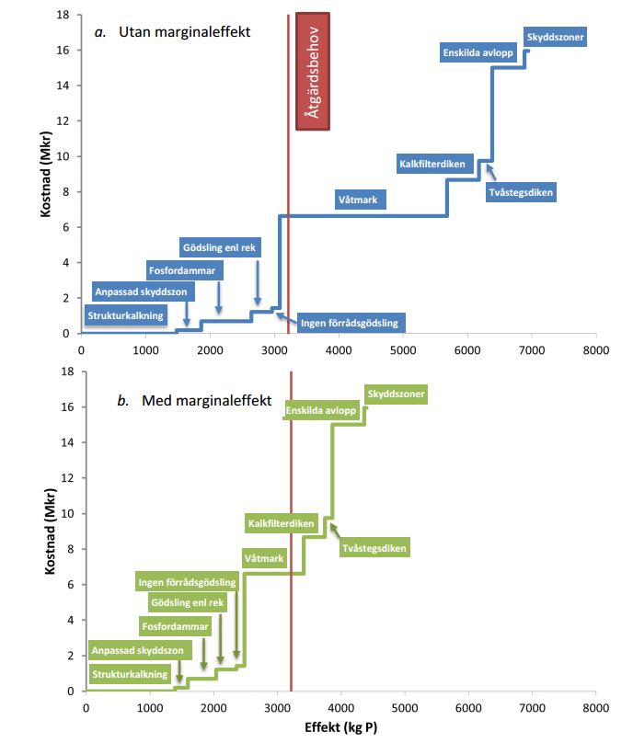

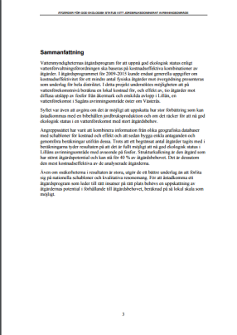
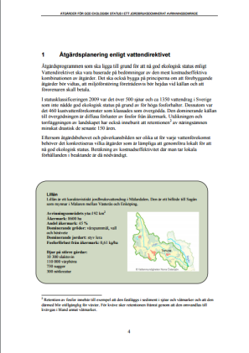
Staircase framework – illustrative example
3
For inspiration (in Swedish), please see the action plan in Lillån, Norra Östersjön:
http://www.vattenmyndigheterna.se/SiteCollectionDocuments/sv/norra-ostersjon/publikationer/%C3%85tg%C3%A4rdsplanering%20f%C3%B6r%20god%20status%20-%20Lill%C3%A5n%20130926.pdf

Slide 6
Staircase framework – template to fill out
3
Measure | Cost / yr (i.e. cost for creating/maintaining the measure) | Potential / yr (i.e. how much the measure can reduce within the municipality) | Cost-effectiveness (e.g. €/kg/yr) | Comment
Wetland | € 560,000 / yr | 2,600 kg/yr | 215 €/kg/yr | Example

